Slide 2
Hands-On Session: PIRCHE & HLA-EMMA

Slide 3
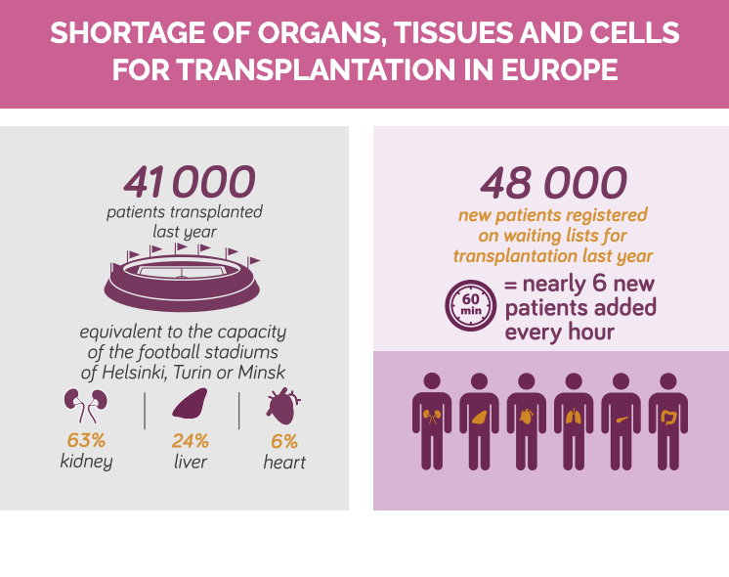
Despite all efforts ….
https://www.coe.int/en/web/human-rights-channel/organ-donation

Slide 4
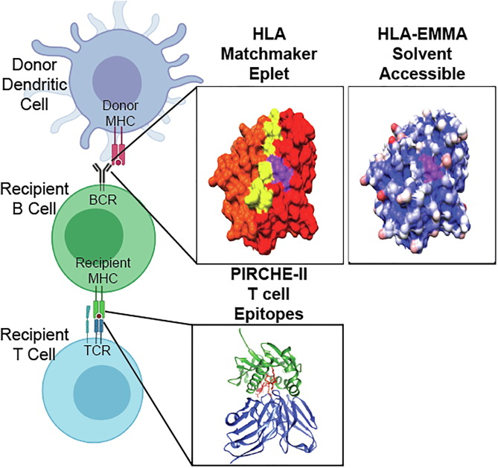
Predicting AB response to MISMATCH HLA

Slide 5
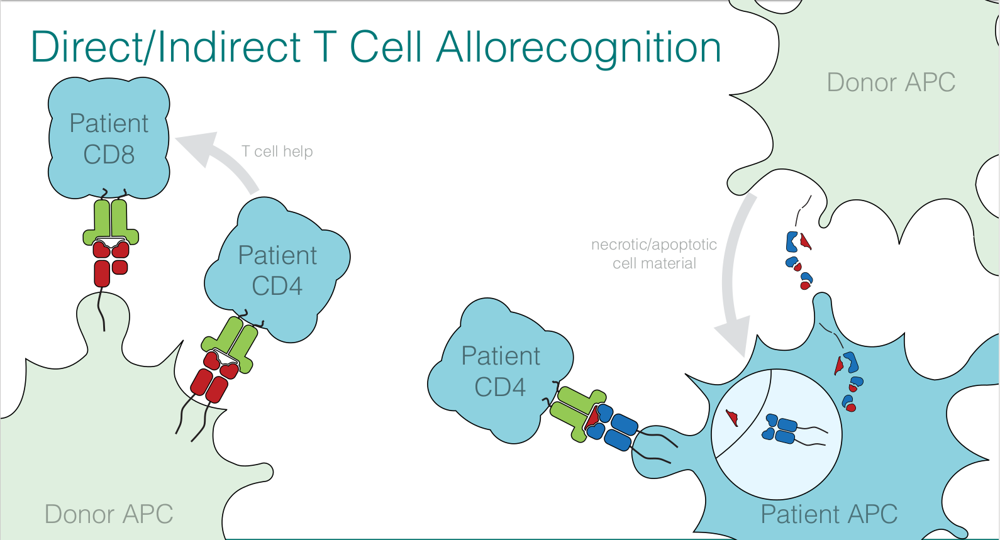
Direct/Indirect T cell recognition of Mismatched HLA
(Tumor)
(Tumor)
Red = ULISES Immunizer HLA

Slide 6
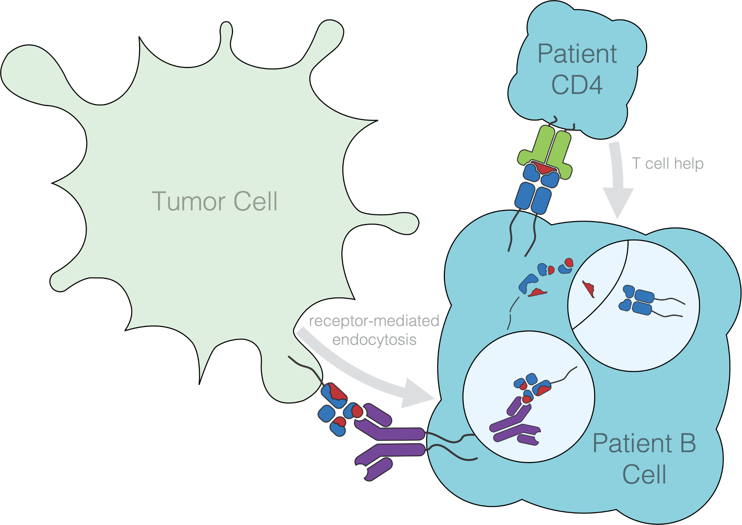
Dual Immunogenecity Models
Immunizer peptide
presented on Patient’s HLA (PIRCHE)
Epitope on Immunizer HLA (HLA-EMMA)

Slide 7
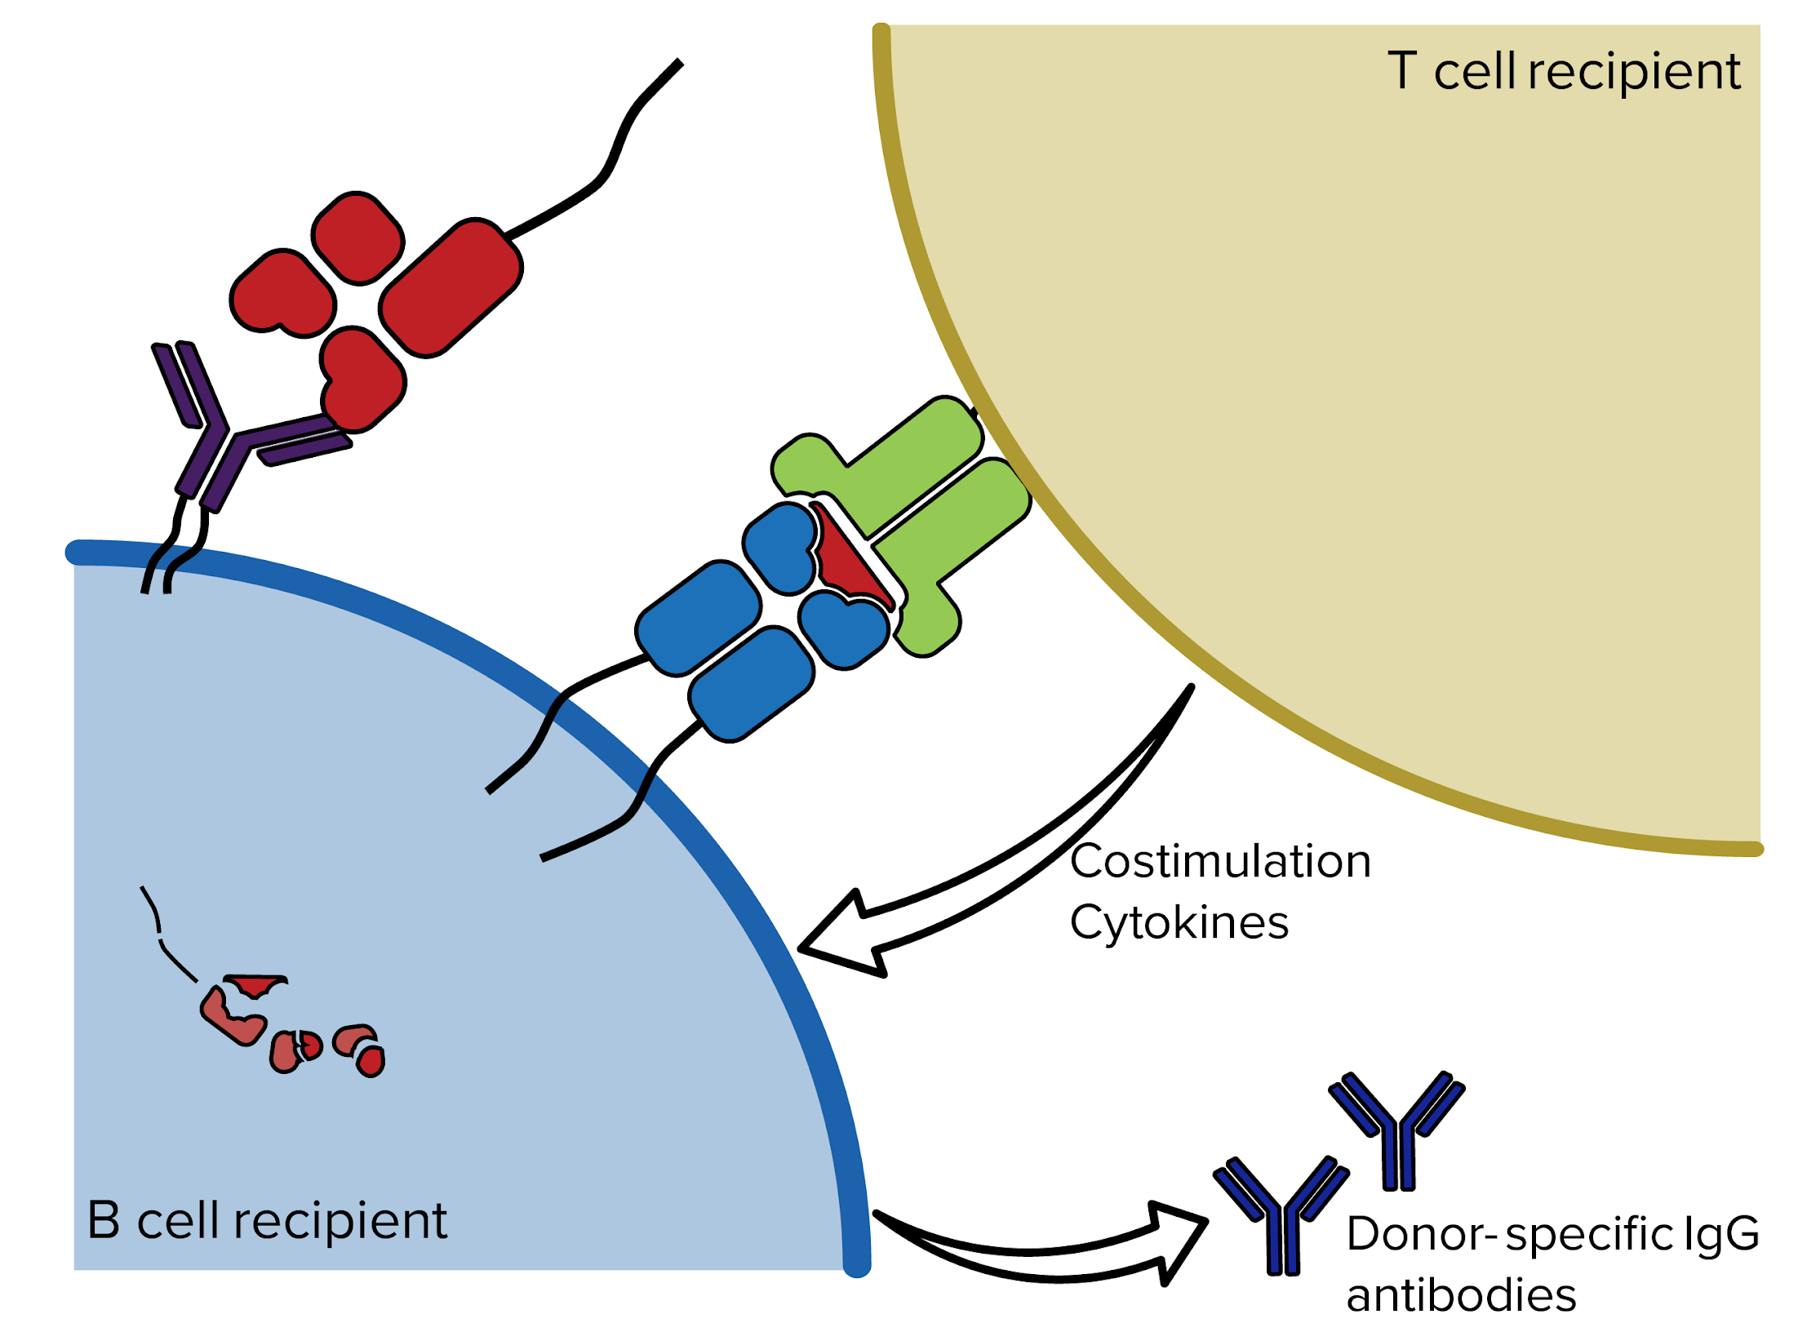

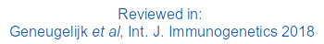
PIRCHE Algortihm to predict T cell Epitopes
PIRCHE = Predicted Indirectly Recognizable HLA Epitopes
→ predicts epitopes due to HLA mismatches
(peptides that differ between host and graft) prior to transplantation
→ high PIRCHE numbers = high risk for alloreactivity
→ In this Tutorial we will focus on PIRCHE-II
Dr. Eric Spierings

Slide 8




STEP 1
Which parts of the HLA mismatch are not present in the HLA of the recipient?
Donor
Recipient
=
🡺
Self peptide
≠
🡺
Non-self peptide

Slide 9
STEP II
Recipient
HLA class II
Donor
Recipient
?
Which parts of the HLA mismatch are not present in the HLA of the Recipient?
Check binding of these parts to recipient HLA class II (NetMHCIIpan).
=
🡺
Self peptide
≠
🡺
Non-self peptide

